Slide 1


National & International Scholarship Awards
Ph.D. Global Vision Scholarship from Inha University (South Korea)
EDISU Merit Scholarship for MS. Studies (Italy)
Erasmus/LLP Scholarship for MS. Thesis (Sweden)
Merit based scholarship for BS Engineering (Pakistan)

Slide 2







National & International Experience
Assistant Professor at NUST (2024~Present) - Pakistan
Postdoctoral Researcher at KENTECH – South Korea
Lecture Assistant at Inha University – South Korea
Lab Engineer/Lecturer at Effat University – Saudi Arabia
Teaching Assistant at Politechnico di Torino

Slide 3




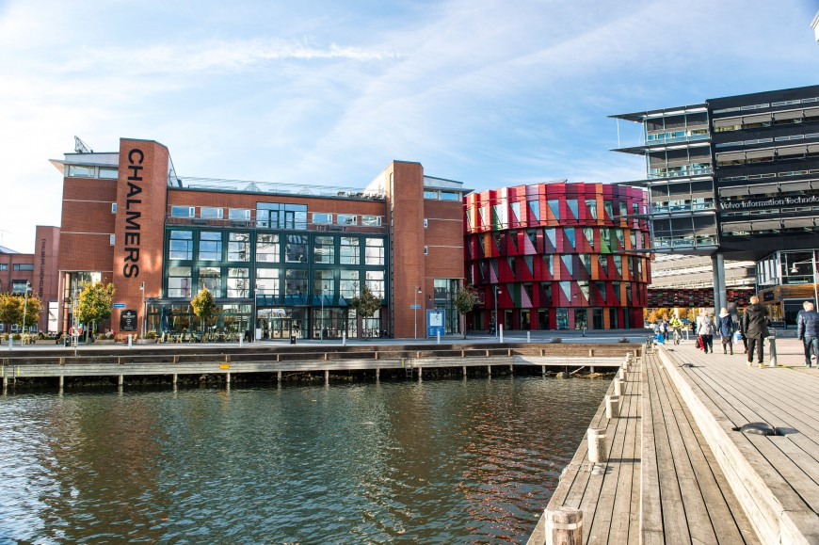
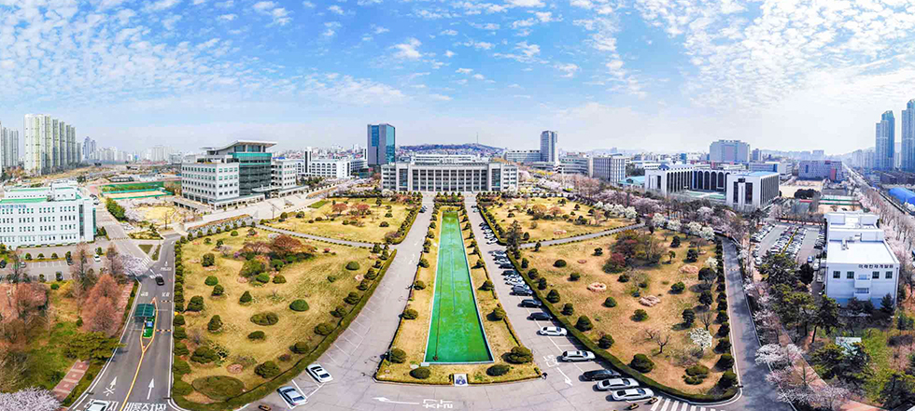
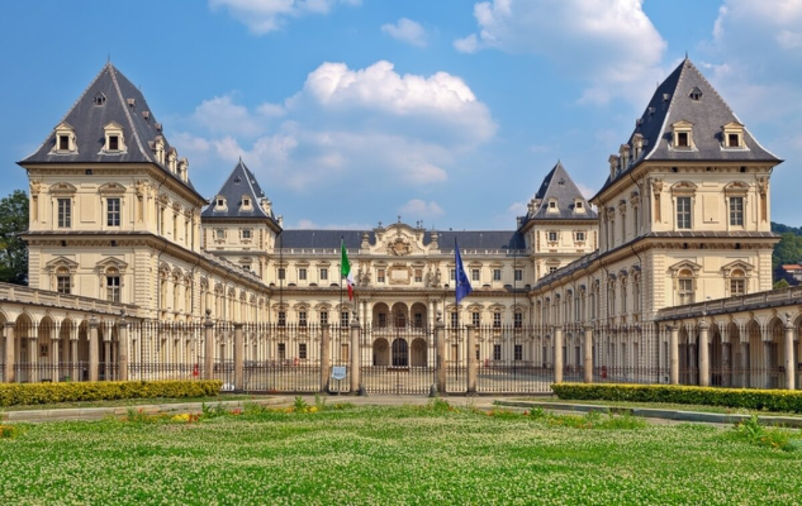
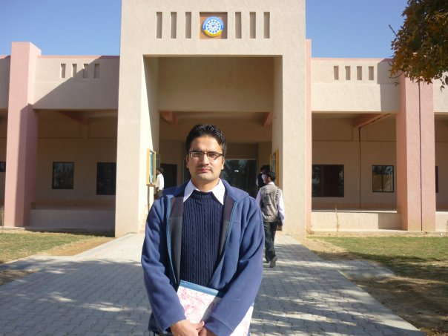
National & International Scholarship Awards
Ph.D. (2020~2023)
Global Vision Scholarship
MS. (2012~2013)
EDISU Merit Scholarship
MS. (Feb 2013~ Sep 2013)
Erasmus/LLP Scholarship
BS. (2006~ Sep 2010)
Merit scholarship

Slide 4

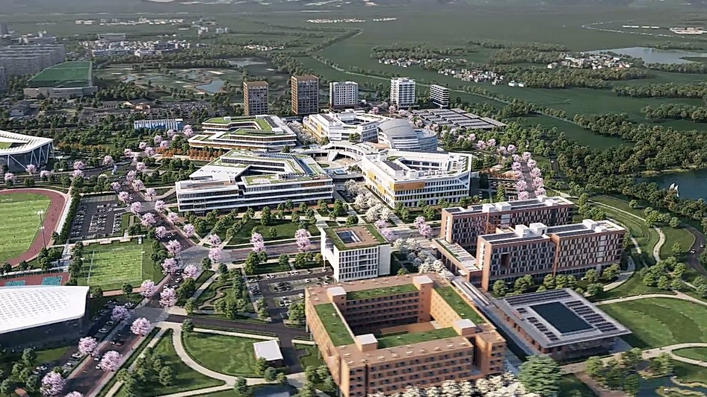
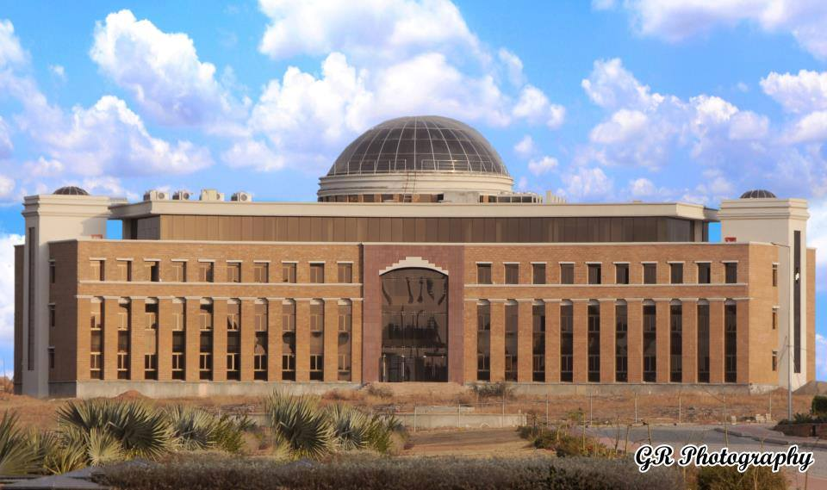
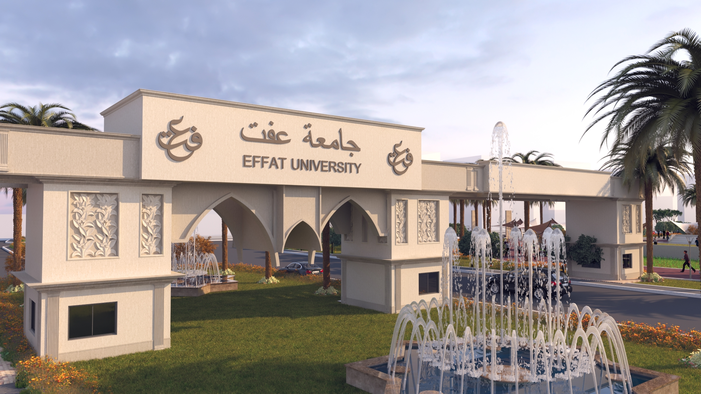
National & International Experience
MS. (Fall 2013)
Teaching Assistant (TA)
(2014~2019)
Lab Engineer & Lecturer
Ph.D. (2020~2021)
Lecture Assistant (LA)
(2023~2024)
Postdoctoral Researcher
(2024~Present)
Assistant Professor

Slide 5





International Collaborations

